Slide 1

Monitoring Mobile Usage In Classroom 16P31
BANGALORE INSTITUTE OF TECHNOLOGY K. R. Road, V. V. Pura, Bengaluru – 560004 Department of Computer Science and Engineering
Presented By: Under the Guidance of:
APOORVA R S (1BI17CS402) Dr. J. Girija
ARCHITHA RAMESH (1BI17CS403) Associate Professor
BHUMIKA A (1BI17CS405) Dept. of Computer Science & Engg
MAHERIA POOJA RAJEEV (1BI16CS070)

Slide 2
Project Features
Introduction to the Project work
A cell phone can easily turn from “classroom learning tool” into “classroom disruption”
The mobile usage monitoring system has emerged as a platform to help to detect presence and usage of mobile phones in class.
This helps the tutor to monitor the usage of mobile phones in the classroom when he is teaching.
It is important so that discipline can be maintained well in the class

Slide 3
Objectives
To minimize the traditional observation process by tutor.
To solve the issue of using phone in restricted areas.
To design a system that is functional in any institute.

Slide 4
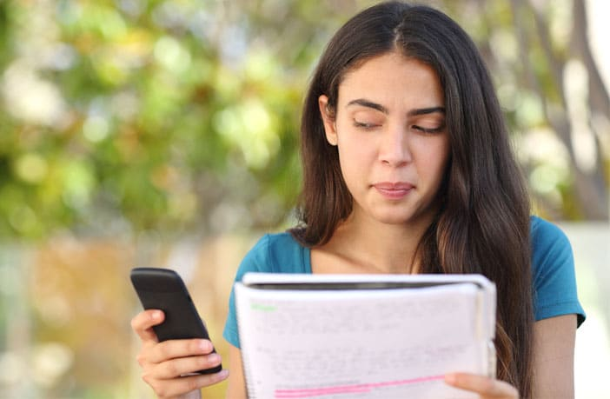
Motivation
To reduce the manual monitoring methods taken by tutors and reduce the disturbances caused in the class.

Slide 5
Main features of Project
Face Recognition
Behavioral analysis
Head Bending
Drowsiness
Yawning
Object Detection
Mobile Detection
Book
Water Bottle

Slide 6
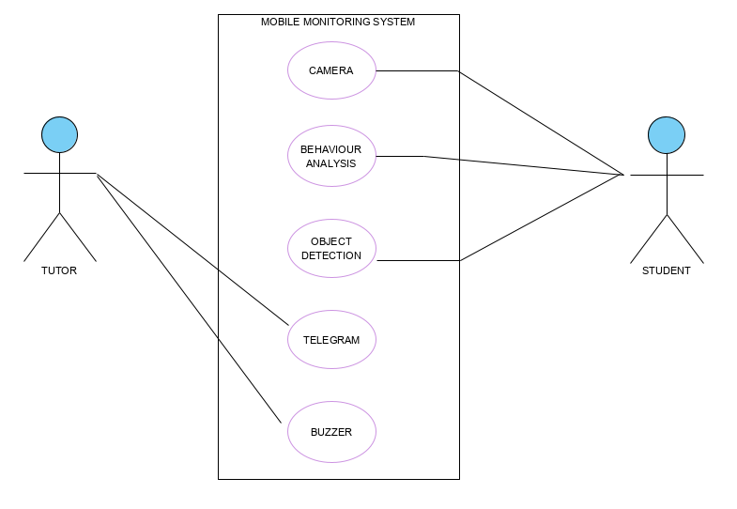
Analysis Modeling
Use case diagram
Fig 1: User and System Interaction

Slide 7
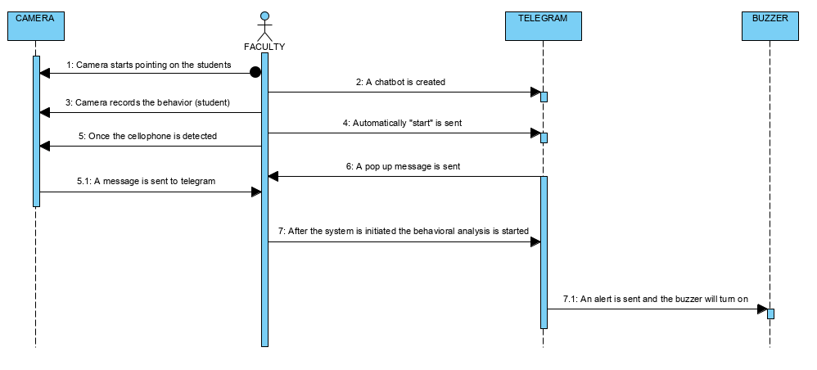
Sequence diagram
Fig 2: Sequence Flow diagram

Slide 8
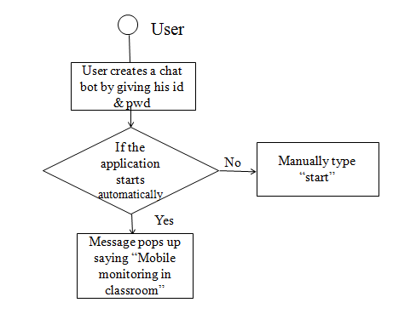
Activity Diagram
Fig 3: User activity diagram

Slide 9
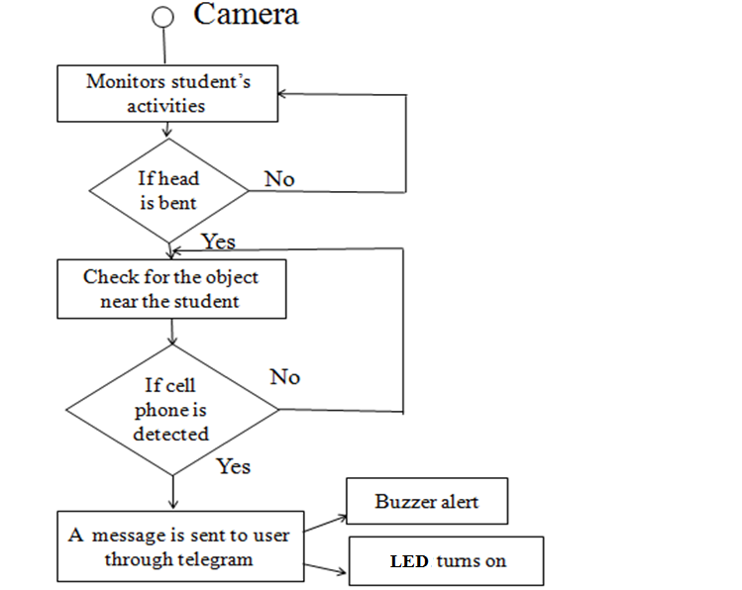
Fig 3.1 : Camera Activity Diagram.

Slide 10
System Requirement Specification
Functional Requirements | Non-Functional Requirements
System should be able to recognize face Behavioural analysis of students will be done such as Drowsiness Yawning Head bending System should be able to detect cell phone. Intimation to the faculty when the cell phone is detected must be accomplished. Buzzer and LED alert should be available. | Usability Easy Interface for capture of image Automatically Update the behaviour Automatically Detect the Cell phone Reliability Easy Update Automatic Intimation Performance Should not take excessive time in Recognizing the Face and Mobile Supportability Contain easy to understand code with provisions for future enhancement Cost The cost of constructing the system should be affordable to all Institutions

Slide 11
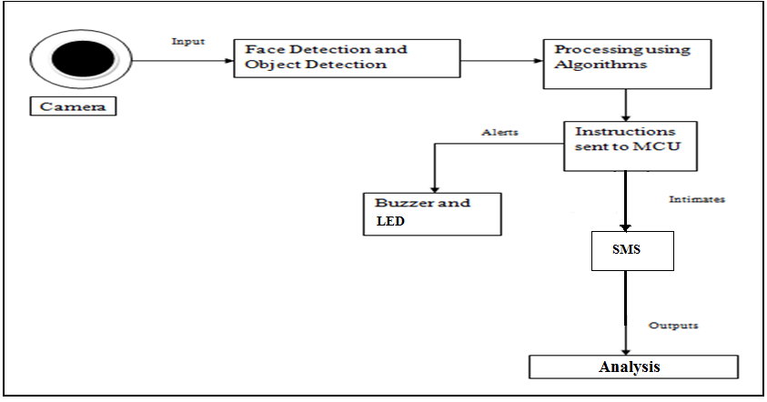
System Architecture
System architecture is a conceptual model that defines the structure and behavior of the system. It comprises of the system components and the relationship describing how they work together to implement the overall system.
Fig 4 : System Architecture

Slide 12
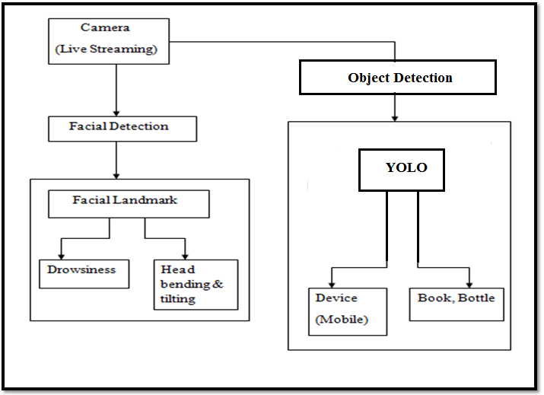
Interface Design
Fig 5 : Interface Diagram

Slide 13
Interface Description
Camera: live streaming is carried out.
Face Detection: It uses the algorithm called facial landmark. It can detect drowsiness, head bending .
Object Detection: It uses the algorithm called Yolo. It detects the object present in an image

Slide 14
ALGORITHMS
Facial Landmark Detection Algorithm :
Step1 : First a classifier is trained with a few hundred sample views of a particular object i.e. face, called positive examples. Once the classifier is trained it can be applied to region of interest in an input image and the classifier outputs 1 if the region contains face otherwise 0
import dlib
import cv2
face_cascade=cv2.CascadeClassifier('haarcascade_frontalface_default.xml)
print("-> Starting Video Stream")
vs = VideoStream(src=args["webcam"]).start()
frame = vs.read()
Step2 : Next converting the image into grayscale
gray=cv2.cvtColor(frame,cv2.COLOR_BGR2GRAY)

Slide 15
Step3: To detect the face inside grayscale image
faces=face_cascade.detectMultiface(gray,1.1,4)
Step4: To iterate over a detected face and draw a rectangle/
bounding box on them
for(x,y,w,h) in faces:
cv2.rectangle(frame,(x,y),(x+w),(y+h),(255,0,0),3)
Step 5: Then finally facial landmarks are created for the detected face by including shape predictor (.dat file) which is used to extract features from the image like eye corners , upper lips etc.
predictor = dlib.shape_predictor('shape_predictor_68_face_landmarks.dat')

Slide 16
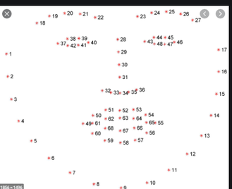
Fig 6 : Facial landmark of detected face

Slide 17
Code snippet for yawning
#To calculate the upper lip and lower lip value and finding the mean value
def lip_distance(shape):
top_lip = shape[50:53]
top_lip = np.concatenate((top_lip, shape[61:64]))
low_lip = shape[56:59]
low_lip = np.concatenate((low_lip, shape[65:68]))
top_mean = np.mean(top_lip, axis=0)
low_mean = np.mean(low_lip, axis=0)
distance = abs(top_mean[1] - low_mean[1])
return distance
YAWN_THRESH = 20
if (distance > YAWN_THRESH):
print('Yawn ALERT!')
cv2.putText(frame, "Yawn Alert", (10, 30), cv2.FONT_HERSHEY_SIMPLEX, 0.7, (0, 0, 255), 2)

Slide 18
Code snippet for Drowsiness
def eye_aspect_ratio(eye):
# compute the euclidean distances between vertical eye landmarks(x,y)
A = dist.euclidean(eye[1], eye[5])
B = dist.euclidean(eye[2], eye[4])
#compute the euclidean distance between horizontal eye landmarks(x,y)
C = dist.euclidean(eye[0], eye[3])
#compute the eye aspect ratio
ear = (A + B) / (2.0 * C)
return ear

Slide 19
To calculate final ear
def final_ear(shape):
(lStart, lEnd) = face_utils.FACIAL_LANDMARKS_IDXS["left_eye"]
(rStart, rEnd) = face_utils.FACIAL_LANDMARKS_IDXS["right_eye"]
leftEye = shape[lStart:lEnd]
rightEye = shape[rStart:rEnd]
leftEAR = eye_aspect_ratio(leftEye)
rightEAR = eye_aspect_ratio(rightEye)
ear = (leftEAR + rightEAR) / 2.0
return (ear, leftEye, rightEye)
EYE_AR_THRESH = 0.3
if ear < EYE_AR_THRESH:
cv2.putText(frame, "DROWSINESS ALERT!", (10, 30),
cv2.FONT_HERSHEY_SIMPLEX, 0.7, (0, 0, 255), 2)

Slide 20
Cell phone detection
In cell phone detection process, we use object detection algorithm YOLO(You Only Look Once).
We have used Darknet as a framework for training YOLO in our project.
Darknet: It is an open source framework written in C, to train neural networks.
Advantages of using Darknet: It is faster and easier to deploy YOLO.

Slide 21
YOLO- You Only Look Once
The YOLO model was first described by Joseph Redmon in 2015.
The algorithm applies a single convolutional neural network to the full image input, that is why it is called look once.
Then divides image into regions and predicts bounding boxes and probabilities for each region.
The model works by first splitting the input image into a grid of cells, where each cell is responsible for predicting a bounding box.

Slide 22
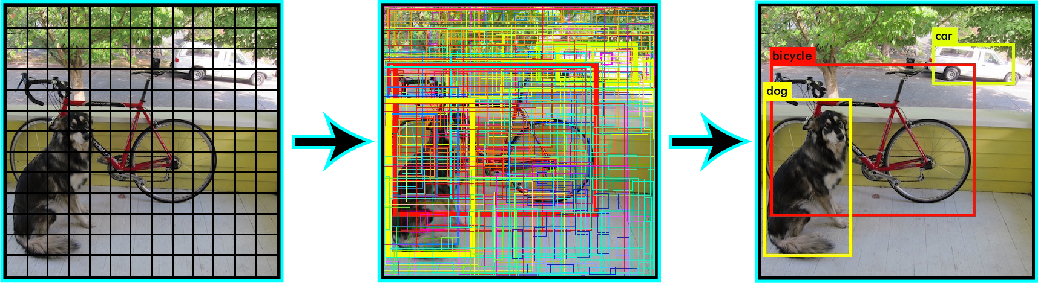
Fig 7 : Yolo prediction

Slide 23
An image may be divided into a 7×7 grid and each cell in the grid may predict 2 bounding boxes, resulting in 94 proposed bounding box predictions.
The class probabilities map and the bounding boxes with confidences are then combined into a final set of bounding boxes and class labels.
Yolo outputs a confidence score telling us how certain it is that the predicted bounding box encloses some object.
Higher the confidence score, fatter the box is drawn. For each box, it predicts a class.

Slide 24
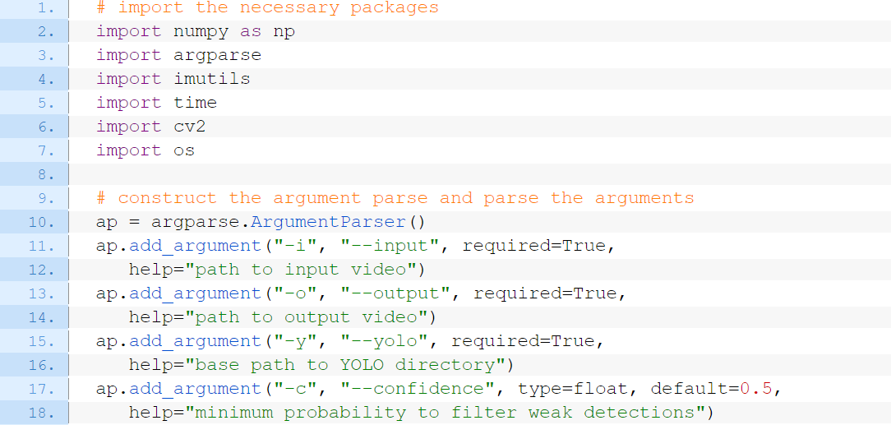
YOLO Code Snippet
--input : The path to the input video file.
--output : Our path to the output video file.
--yolo : The base path to the YOLO directory.
--confidence : Minimum probability to filter weak detections. We have taken default value of 50%.

Slide 25
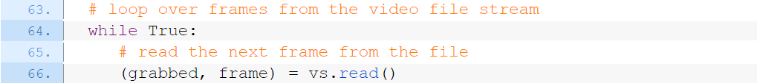
We use YOLO trained on the COCO dataset.
The COCO dataset is an excellent object detection dataset with 80 classes, 80,000 training images and 40,000 validation images.
The COCO dataset consists of 80 labels, including cell phone.
We capture frame by frame from the input video by grabbing frame one at a time.

Slide 26
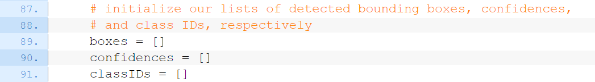
The following lists include:
boxes : Our bounding boxes around the object.
confidences : The confidence value that YOLO assigns to an object. Lower confidence values indicate that the object might not be what the network thinks it is. We filter out objects that don’t meet 50% confidence.
classIDs : The detected object’s class label.

Slide 27
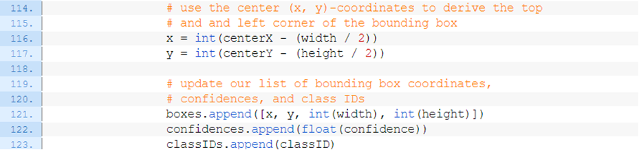
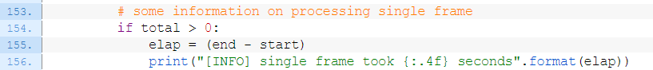
We take bounding boxes with confidence score greater or equal to 50 percent only and thus we are predicting coordinates of the boxes by the below code.
We do this for each frame of input video and display the objects bounded by a box with confidence and label
Printing out estimates of how long it will take to process video

Slide 28
Implementation
Module1 : Facial behavior detection
To detect the face by using camera and identify head bend, yawning or drowsiness(eyes closed) using facial landmark algorithm. Also alerts will be sent to the node mcu serially.
Module 2 : Object detection
To detect the object which is mainly cell phone in our project, we have used YOLO object detection algorithm.
Module 3 : Buzzer and LED
Once the student is detected using cell phone, buzzer is activated and a beep sound is heard and even led light is on.
Module 4 : Message alert
Telegram message is sent to the teacher intimating the usage of mobile phone by the student or if student is drowsing in the class.

Slide 29
DEMO

Slide 30
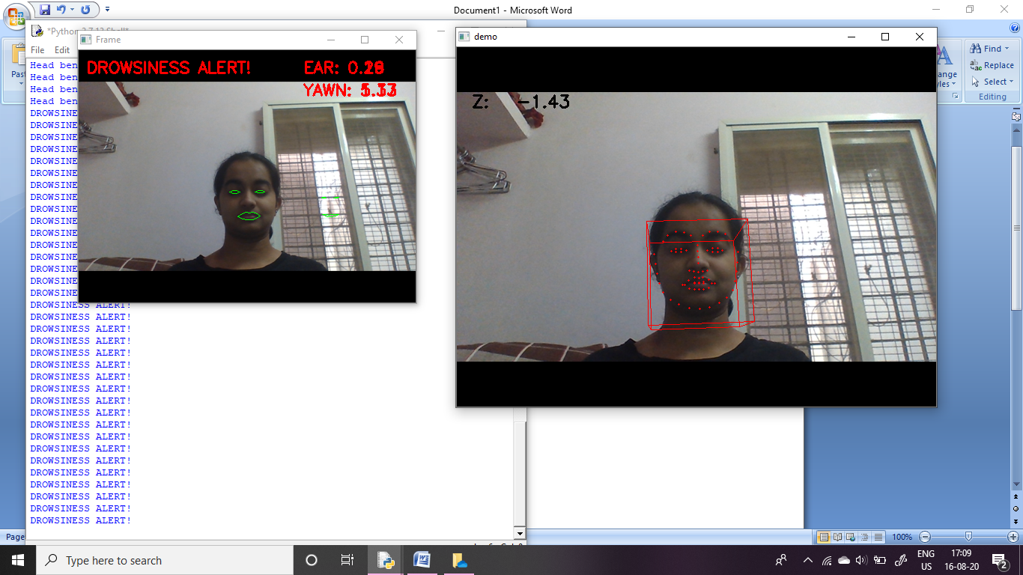
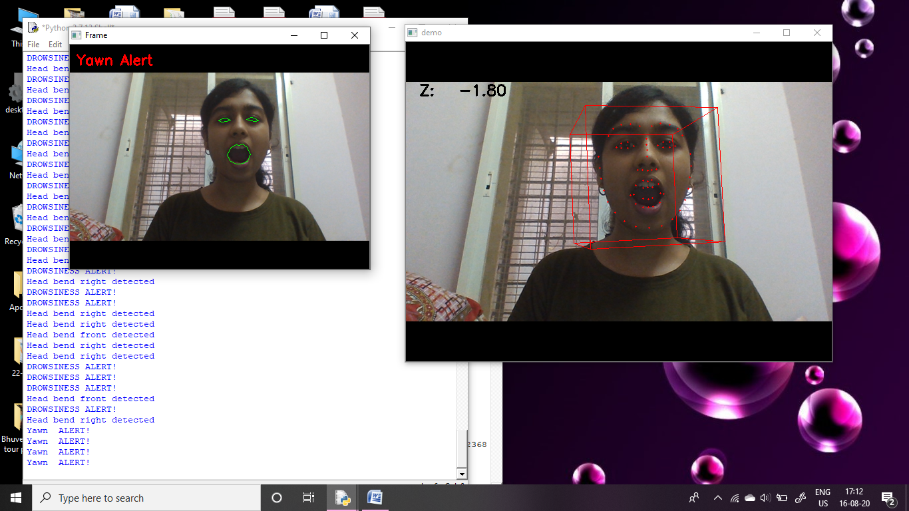
Results
Fig 8 : Drowsiness alert
Fig 9 : Yawn alert

Slide 31
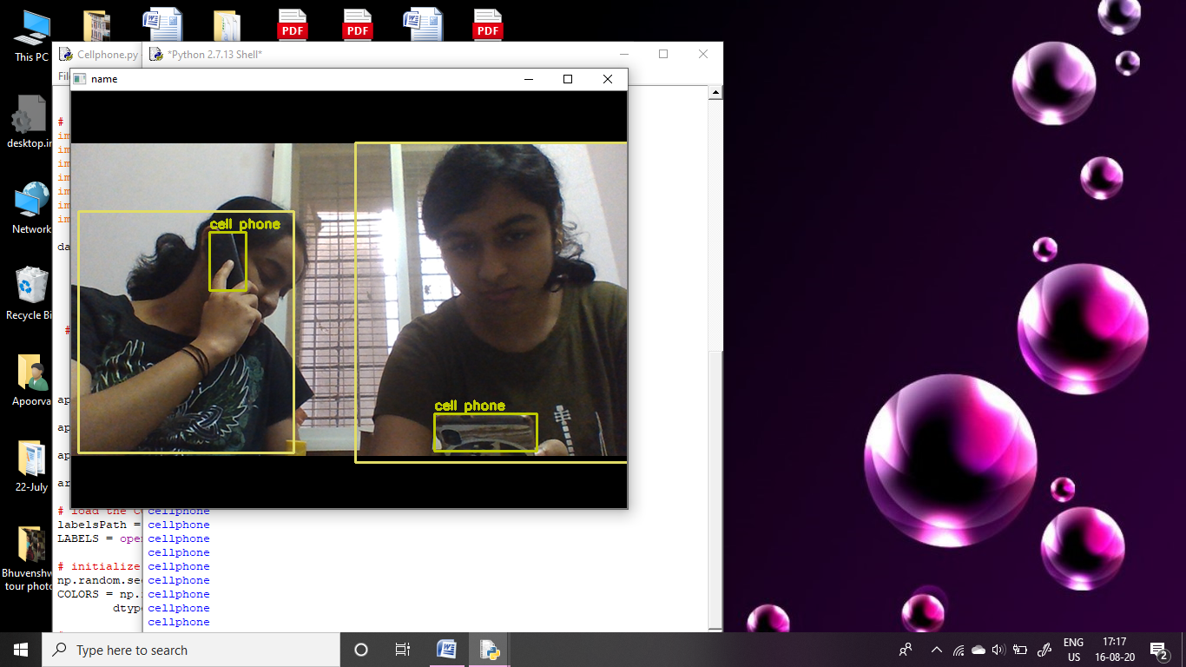
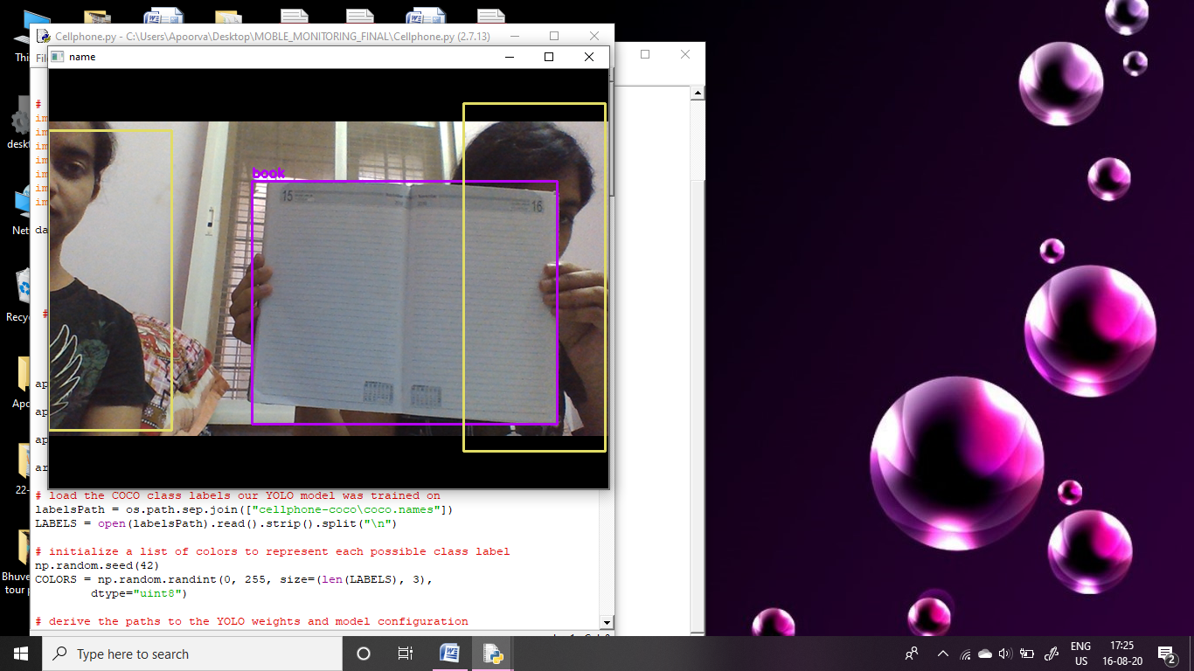
Fig 10 : Cell phone detection
Fig 11 : Book detection

Slide 32
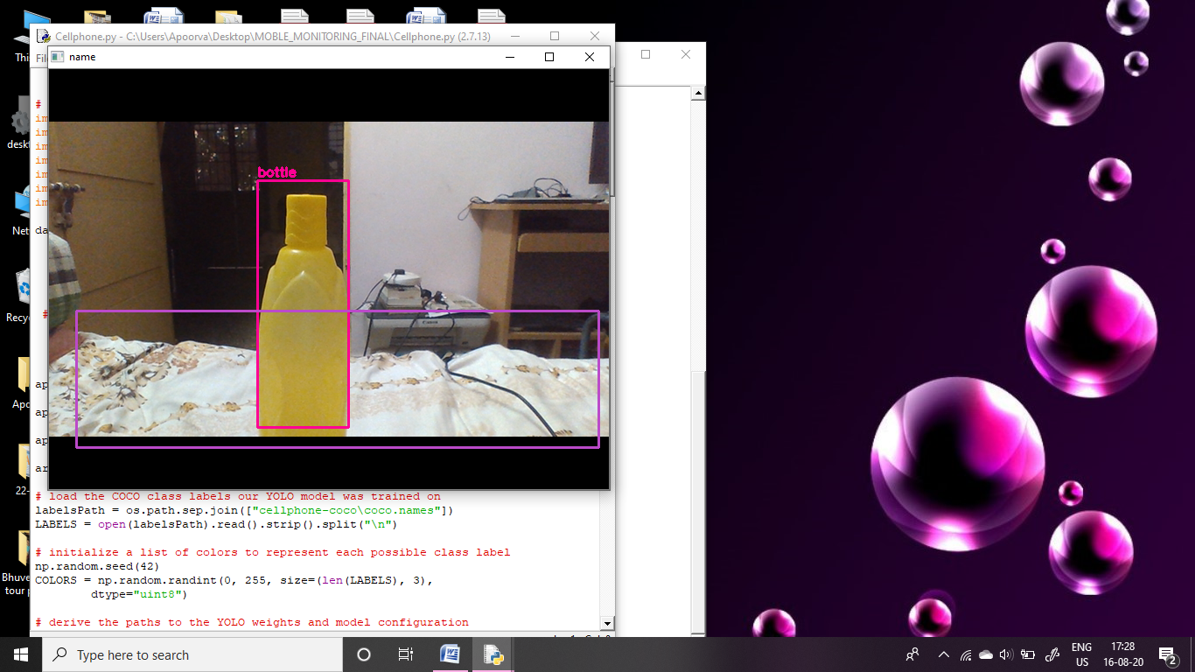
Fig 12 : Water bottle detection

Slide 33
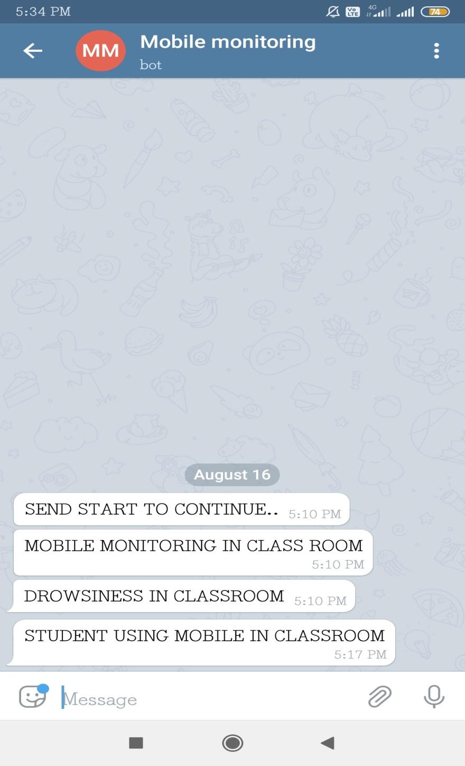
Fig 13 :Message alert

Slide 34
Applications
Government Sectors for monitoring officers Activities
Monitoring the student’s activities and behaviors in the classrooms.
Monitoring during the Conference or Meetings.
Use for Behavioral Monitoring in Public Areas.
Few work places where mobile usage is restricted.

Slide 35
Conclusion and Future Work
In this study a monitoring system is proposed that is capable of continuously monitoring the behavior of the students using a fixed camera. The proposed monitoring system consists of three layers which are, face detection, behaviour detection and analysis and object detection. The results achieved prove the validity of our proposed prototype to monitor students successfully by detecting the students in the examination room, and segmenting them successfully from the input camera feed.
Future endeavors are to consider depending on the hand gestures and other clues that student provide while cheating, applying the optical flow method to detect any fast movements could also be a good idea to try to implement.

Slide 36
References
[1] H. Kopetz, “Internet of things,” in Real-time systems. Springer, 2011, pp. 307–323.
[2] R. H. Weber and R. Weber, Internet of things. Springer, 2010, vol. 12.
[3] R. Brunelli and T. Poggio, “Face recognition: Features versus templates,” IEEE transactions on pattern analysis and machine intelligence, vol. 15, no. 10, pp. 1042–1052, 1993.
[4] K.-C. Lee, J. Ho, and D. J. Kriegman, “Acquiring linear subspaces for face recognition under variable lighting,” IEEE Transactions on pattern analysis and machine intelligence, vol. 27, no. 5, pp. 684–698, 2005.
[5] M. A. Turk and A. P. Pentland, “Face recognition using eigenfaces,” in Computer Vision and Pattern Recognition, 1991. Proceedings CVPR’91., IEEE Computer Society Conference on. IEEE, 1991, pp. 586–591.

Slide 37


